Slide 1


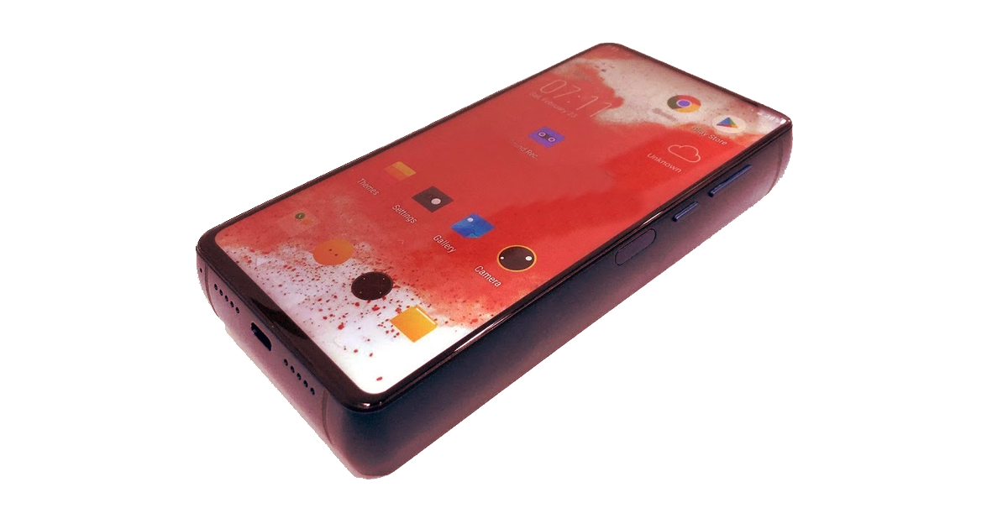
Elektrik XL

Slide 2
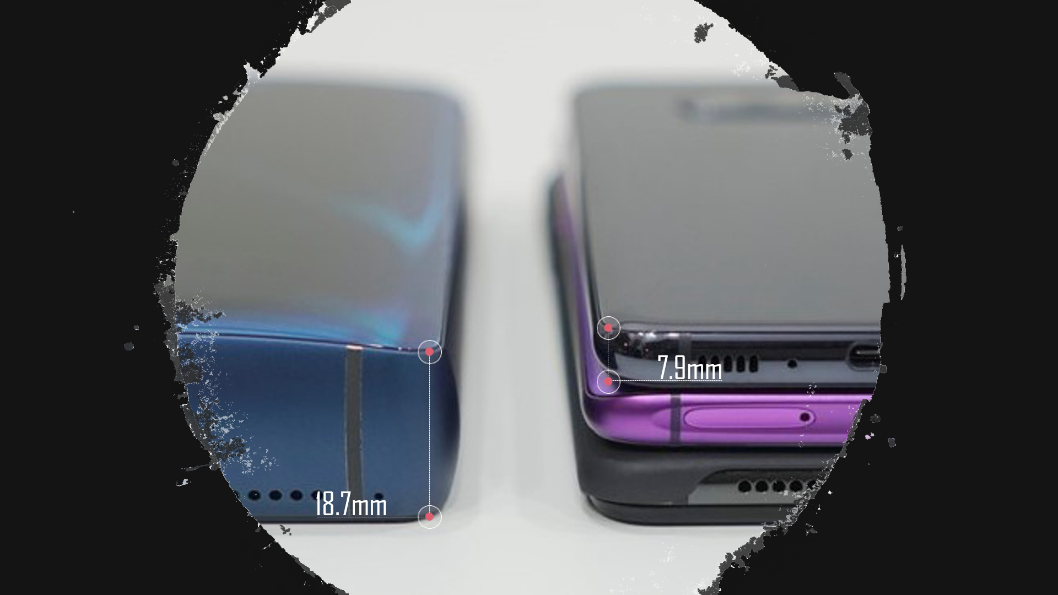

Slide 3

Pro’s
Unique Design
Superior battery life

Slide 4





Slide 5
Pro’s
Excellent OS
USB-C w/ quick charging

Slide 6
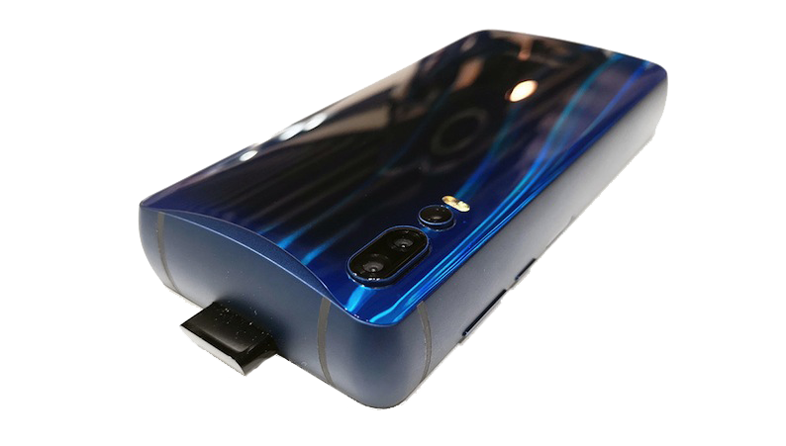
Pro’s
Ergonomic Design
Battery acts as a power bank
5 Cameras

Slide 7




Price Breakdown
Elektrik XL Elektrik XL+
64 GB Storage
6GB RAM
$750 USD
1TB Storage
12GB RAM
$850 USD

Slide 8
It is easily recognized
Trends has several components, which includes: identifiability, relativeness, and popularity
Why Is This a Trend?
The next generation for phones
Falls in line with the modern concept of "Bigger screen, bigger battery, better phone"

